Slide 1
Experiments to determine how likely an outcome is
Probability: possible outcomes

Slide 2
How our teaching resources are designed for the classroom

Slide 3
I can determine the likelihood of an outcome by designing and carrying out an experiment.

Slide 4
An experiment is a repetition of a trial multiple times in order to observe how often each outcome occurs.

Slide 5

Experiments to determine how likely an outcome is
Planning and conducting experiments
Considering the number of trials required

Slide 6

Planning and conducting experiments
When flipping a fair coin, there are two possible outcomes: the coin lands showing ‘heads’ or the coin lands showing ‘tails’.
trial: flipping a coin once
ξ = {heads, tails}
Each outcome is equally likely to happen.
Because these are the only two possible outcomes, the likelihood of each outcome is an even chance.
heads tails
impossible
unlikely
even chance
likely
certain

Slide 7
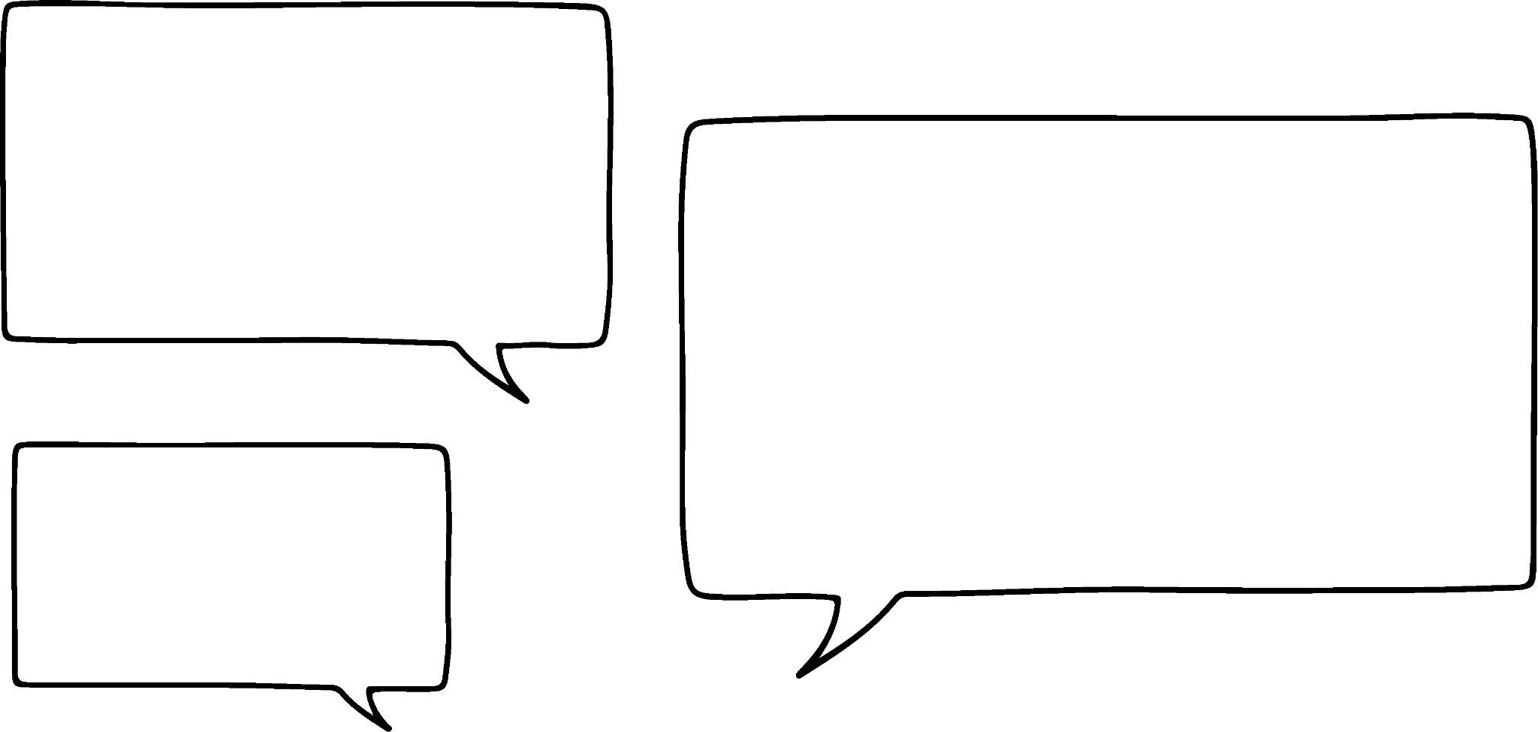
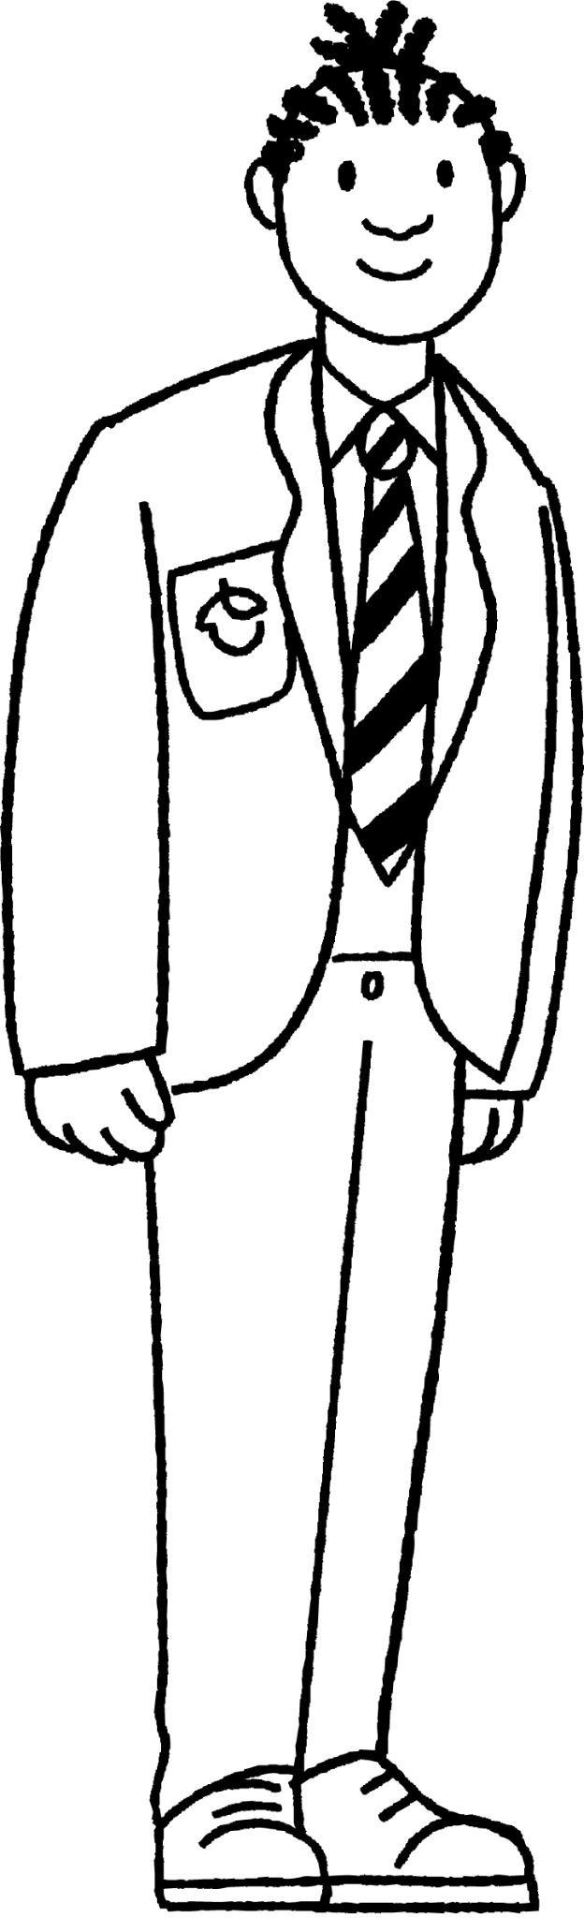
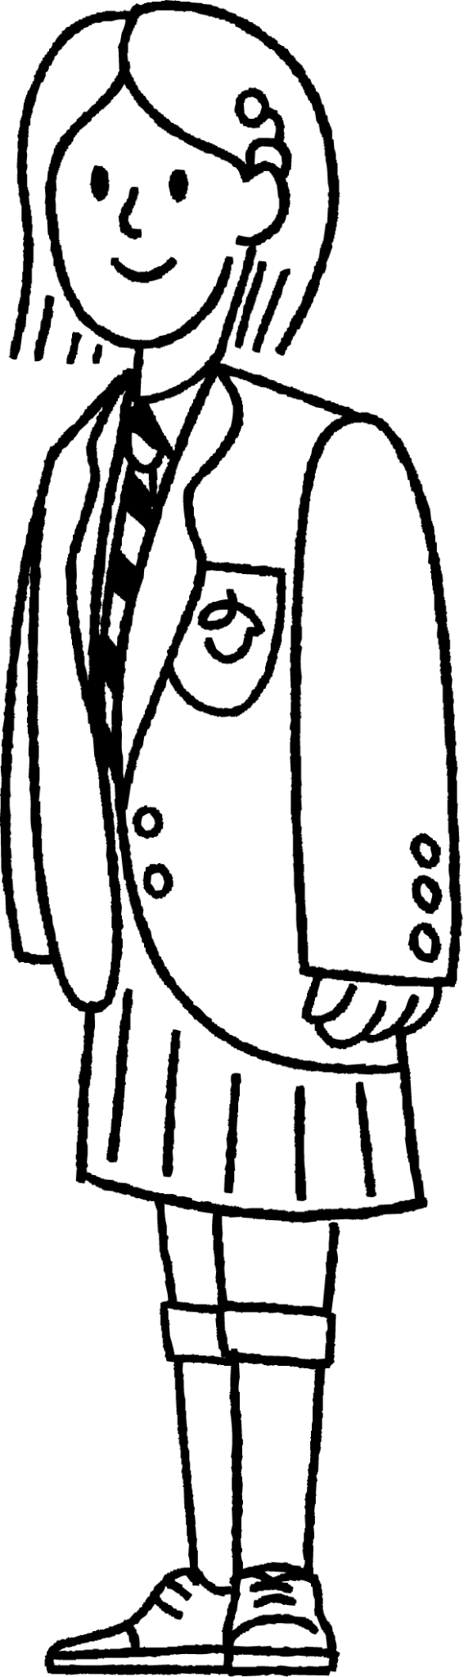

Planning and conducting experiments
Jacob and Sofia are playing with a frisbee.
If I flip this frisbee in the air, there are two possible ways that it could land.
The shape of the frisbee means that its two sides are different. So, it could be more likely to land one way than the other.
Do you think the two outcomes are equally likely?
trial: spinning a frisbee ξ = { , }
How could they investigate whether one outcome is more likely than the other?

Slide 8
Planning and conducting experiments
To make it easier to talk about the outcomes, we could call one outcome ‘heads’ and the other outcome ‘tails’.
We could flip the frisbee in the air several times and see which outcome occurs the most.
That could give us an indication whether one outcome is more likely than the other.
trial: spinning a frisbee ξ = {heads, tails}
heads =
tails =

Slide 9

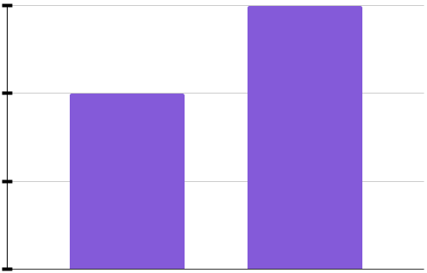
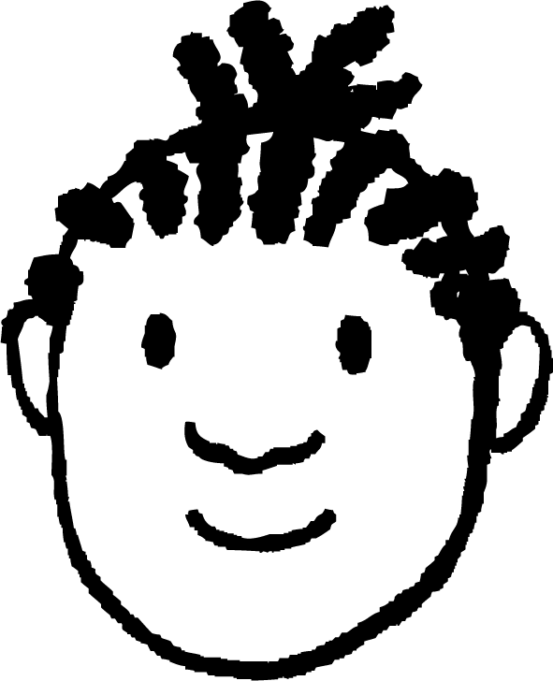

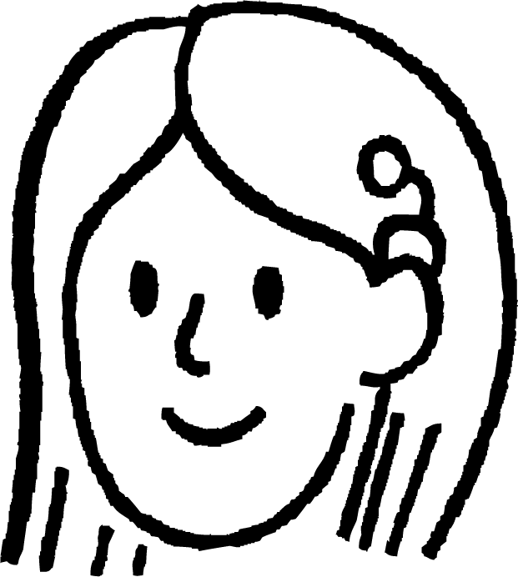
Planning and conducting experiments
They flip the frisbee in the air 10 times and record the results.
The results were 4 heads and 6 tails.
So could we conclude that the frisbee is more likely to land on tails than heads?
6
4
frequency
Hmm, possibly. But this experiment hasn’t really convinced me.
2
0
heads
tails
How could they be more confident about their conclusion?

Slide 10
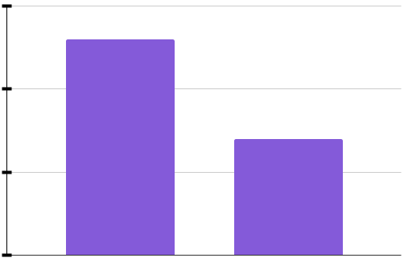

Planning and conducting experiments
They flip the frisbee in the air 20 times and record the results.
This time there were 13 heads and 7 tails.
That would suggest a different conclusion: the frisbee is more likely to land on heads than tails.
15
10
frequency
These results seem a little more trustworthy. But I’m still not fully convinced.
5
0
heads
tails
How could they be even more confident about their conclusion?

Slide 11
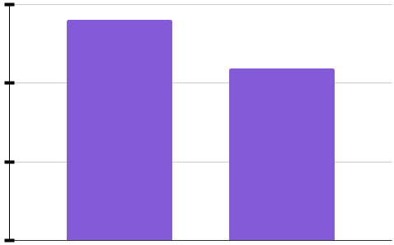
Planning and conducting experiments
They flip the frisbee in the air 500 times and record the results.
The results were 281 heads and 219 tails.
Could we conclude that the frisbee is more likely to land on heads than tails?
300
200
frequency
We don’t know for absolute certain, but these results could be convincing enough to make that conclusion.
100
0
heads
tails
Use the link for a Desmos simulation and click ‘run’: Frisbee flip simulation🖇

Slide 12
Planning and conducting experiments
An experiment is a repetition of a trial multiple times in order to observe how often each outcome occurs.
If one outcome has a greater frequency than the others, it could suggest that that outcome could have a greater likelihood than the others of occurring again in the future.
We might not be able to be absolutely certain that our conclusions from an experiment are true.
The more trials an experiment contains, the more confident we can be about any conclusions made based on its results.

Slide 13

Planning and conducting experiments
Jacob and Sofia represent the conclusion from their frisbee experiment on a scale of likelihoods.
number of trials = 500
300
That doesn’t look right.
250
200
150
frequency
Why must at least one cross be in the wrong position?
100
50
0
heads
tails
tails
heads
impossible
unlikely
even chance
likely
certain

Slide 14
Planning and conducting experiments
Fewer than half of the trials resulted in ‘tails’.
Therefore, ‘tails’ goes before the halfway point of the scale.
number of trials = 500
300
That means ‘tails’ has less than an even chance.
250
200
150
frequency
The more likely the frisbee is to land ‘heads’, the less likely it is to land ‘tails’.
100
50
0
heads
tails
tails
tails
heads
impossible
unlikely
even chance
likely
certain

Slide 15
Planning and conducting experiments
A toy building brick that is thrown into the air could land in one of four possible ways.
A
B
C
D
connectors up
connectors down
long face
short face
How could you investigate which outcomes are more likely than others?
Conduct an experiment by throwing the toy brick into the air multiple times.

Slide 16

Planning and conducting experiments
An experiment consists of throwing a toy brick in the air 100 times. The results are shown in the bar chart.
The toy brick is about to be thrown in the air again.
Based on these results, which outcome would be the most likely to happen?
frequency
B - connectors down
A
B
C
D

Slide 17

Planning and conducting experiments
number of trials = 100
None of the events have a likelihood that is more than even chance.
40
30
20
10
0
The event with the highest frequency is the most likely, so it has greater than an even chance.
None of the events have a frequency greater than half the number of trials.

Slide 18
Planning and conducting experiments
The markings on the scale represent the likelihoods of each event.
number of trials = 100
40
30
20
Which event is this?
C - long face
10
0
A
B
C
D
impossible
unlikely
even chance
likely
certain

Slide 19

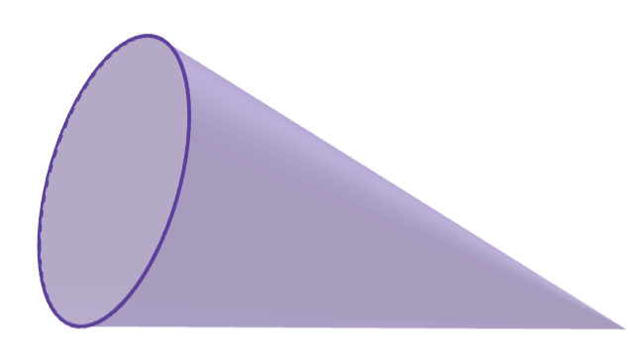
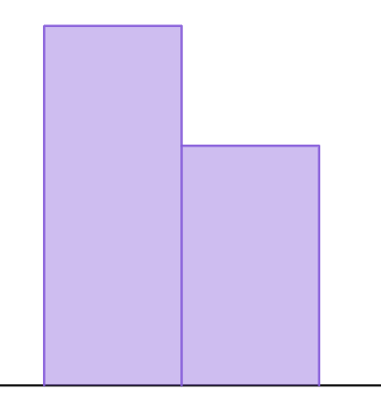
Planning and conducting experiments
1) A dropped cone could land in one of two ways: ‘base down’ or ‘curve down’.
a) Plan an experiment to investigate which outcome is most likely to happen.
A - base down
B - curve down
b) The bar chart shows the results from an experiment.
The cone is about to be dropped again. In which position is it most likely to land?
6
4
frequency
2
0
A
B

Slide 20
Planning and conducting experiments
1) A dropped cone could land in one of two ways: ‘base down’ or ‘curve down’.
A - base down
B - curve down
6
c) Use the link to access a simulation of this experiment: Cone simulation🖇 Press the ‘run’ button to begin the simulation and the ‘reset’ button to start again. Try this multiple times with a large number of trials each time. How do the results affect your answers to part (b)?
4
frequency
2
0
A
B

Slide 21
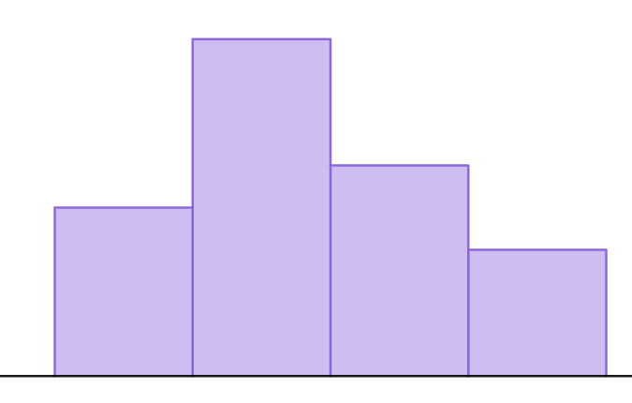
Planning and conducting experiments
2) A toy brick that is thrown into the air could land in one of four possible ways. In an experiment, the toy brick is thrown 20 times and produces the following results.
8
A - up
B - down
6
frequency
4
C - long face
D - short face
2
0
A
B
C
D
a) The toy brick is about to be thrown again. Draw a scale of likelihoods and use the results from the experiment to show the likelihood of each outcome on the scale.

Slide 22
Planning and conducting experiments
b) Use the link to access a simulation of this experiment: Toy brick simulation🖇 Press the ‘run’ button to begin the simulation and the ‘reset’ button to start again. Try this multiple times with a large number of trials each time. How do the results affect your answers to part (a)?

Slide 23
Planning and conducting experiments
1) A dropped cone could land in one of two ways: ‘base down’ or ‘curve down’.
a) Plan an experiment to investigate which outcome is most likely to happen.
A - base down
B - curve down
Example answers -
‘Drop a cone 50 times.’
‘Drop a cone onto the floor from the same height 200 times. Record the number of times it lands in each position.’
Number of trials may vary. A larger number of trials is encouraged but you may also consider practical limitations for an experiment.

Slide 24
Planning and conducting experiments
b) The bar chart shows the results from an experiment. The cone is about to be dropped again. In which position is it most likely to land?
6
4
frequency
2
0
A
B
A - base down

Slide 25
Planning and conducting experiments
c) Use the link to access a simulation of this experiment: Cone simulation🖇 Press the ‘run’ button to begin the simulation and the ‘reset’ button to start again. Try this multiple times with a large number of trials each time. How do the results affect your answers to part (b)?
E.g. ‘When using a large number of trials, the cone lands curve down more often than base down. So curve down appears to be the more likely outcome.’
Answers may vary depending on results from the simulation.

Slide 26
Planning and conducting experiments
2) A toy brick that is thrown into the air could land in one of four possible ways. In an experiment, the toy brick is thrown 20 times and produces the following results.
8
A - up
B - down
6
frequency
4
2
C - long face
D - short face
0
A
B
C
D
a) The toy brick is about to be thrown again. Draw a scale of likelihoods and use the results from the experiment to show the likelihood of each outcome on the scale.
D
A
C
B
impossible
unlikely
even chance
likely
certain

Slide 27
Planning and conducting experiments
b) Use the link to access a simulation of this experiment: Toy brick simulation🖇 Press the ‘run’ button to begin the simulation and the ‘reset’ button to start again. Try this multiple times with a large number of trials each time. How do the results affect your answers to part (a)?
E.g. ‘When using a large number of trials (e.g. 1000) outcome C happens the most often, so appears to have the greatest likelihood. Outcome A happens the least often, so appears to have the least likelihood.’
Answers may vary depending on results from the simulation.

Slide 28
Experiments to determine how likely an outcome is
Planning and conducting experiments
Considering the number of trials required

Slide 29

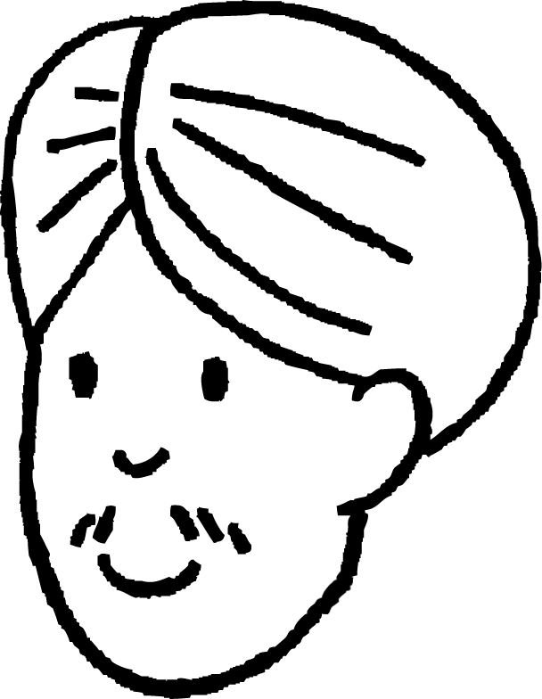
Considering the number of trials required
Laura and Andeep are playing a game that involves rolling a six-sided dice.
I don’t think this dice is fair. It keeps landing on some numbers more than others.
We could investigate whether the dice is fair by running an experiment.
Perhaps is not weighted equally throughout the dice.
How many times should they roll the dice during their experiment?

Slide 30
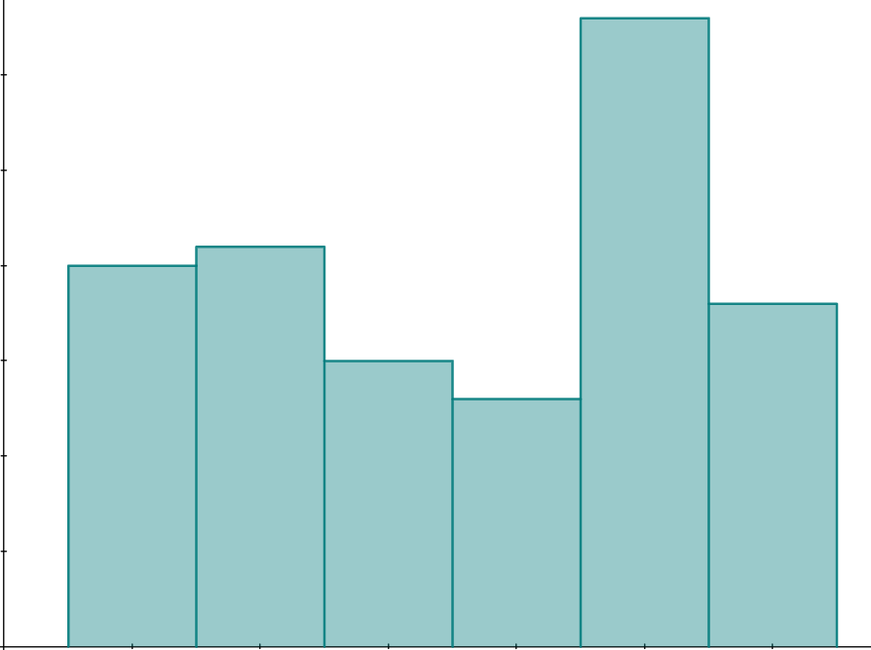
Considering the number of trials required
They carry out an experiment by rolling the dice 120 times.
But even when events have an equal chance of happening, one event can happen more than another.
I told you that the dice wasn’t fair. The frequency for 5 is higher than the others.
30
20
frequency
10
0
1
2
3
4
5
6
number rolled

Slide 31
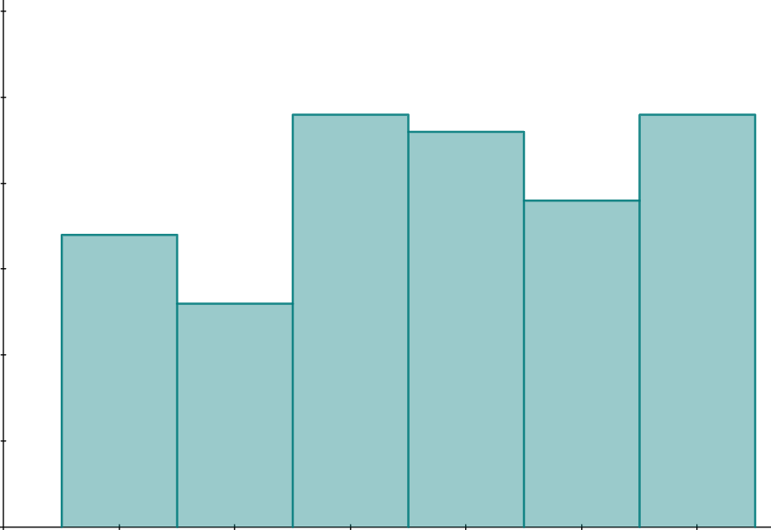
Considering the number of trials required
They carry out the experiment again by rolling the dice 120 times.
Hmm, the results look quite different this time. Now I’m not sure whether the dice is fair.
Maybe 120 trials isn’t enough to make a reliable conclusion.
I wonder what would happen if we ran a lot more trials.
30
20
frequency
10
0
1
2
3
4
5
6
number rolled

Slide 32
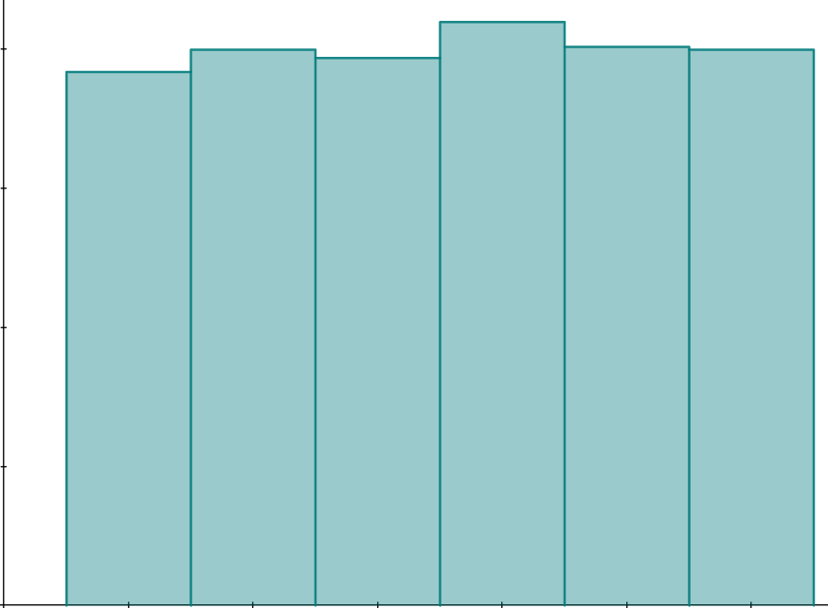
Considering the number of trials required
They carry out the experiment again but this time roll the dice 1200 times (with help from lots of friends).
The more trials we run in an experiment, the more it looks like the numbers on the dice are equally likely.
I wonder why using more trials meant that the dice looked more fair.
200
frequency
100
0
1
2
3
4
5
6
number rolled

Slide 33
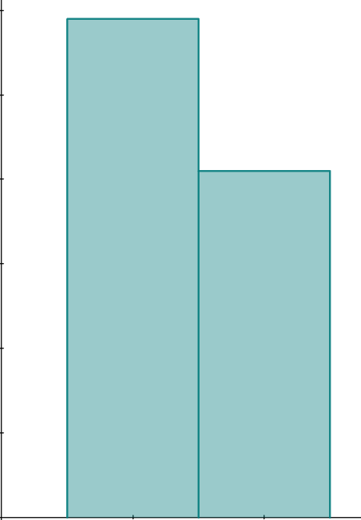
Considering the number of trials required
Even when events are equally likely, they do not necessarily occur an equal number of times during an experiment. One event may occur more often than another by chance.
100 trials
E.g. When flipping a fair coin, the two outcomes (‘heads’ and ‘tails’) are equally likely.
60
40
But you can still get more ‘heads’ than ‘tails’.
frequency
H
20
T
impossible
unlikely
even chance
likely
certain
0
heads
tails
Use the link for simulation results: Fair coin simulations with 100 trials🖇 Move the slider to see results from different simulated experiments.

Slide 34
Considering the number of trials required
Even when one event is more likely to happen than another, the event that is less likely to happen may occur more often during an experiment.
E.g. When flipping a frisbee, you may be slightly more likely to get ‘heads’ than ‘tails’.
100 trials
60
But you can still get more ‘tails’ than ‘heads’.
40
frequency
T
H
20
impossible
unlikely
even chance
likely
certain
0
heads
tails

Slide 35
Considering the number of trials required
An unlikely event can happen more often than a likely event, simply by chance. This tends to happen more often in experiments that have a small number of trials.
The more trials an experiment contains, the more likely we are to observe an accurate picture of the likelihoods for each event.
The more trials an experiment contains, the more confident we can be with conclusions drawn from the experiment about whether one outcome is more likely than another.

Slide 36
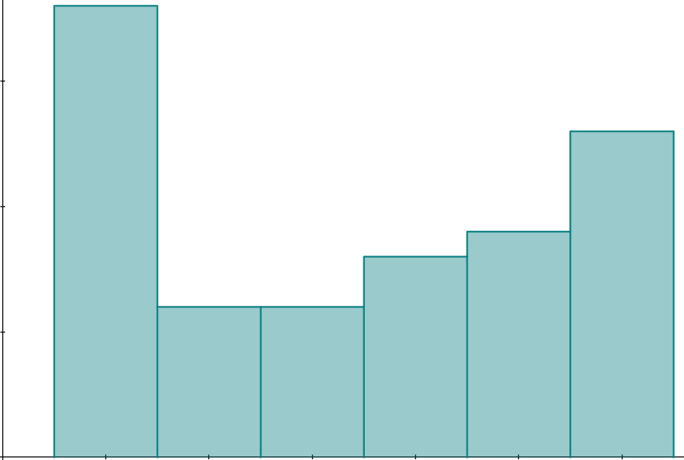
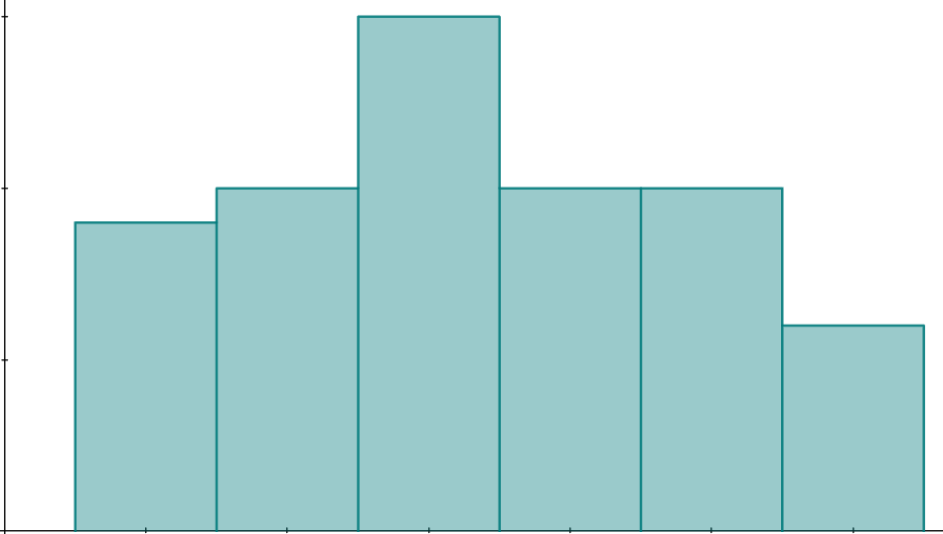
Considering the number of trials required
Experiments with a small number of trials can produce vastly different results.
E.g. rolling a dice 60 times.
20
20
15
15
frequency
frequency
10
10
5
5
0
0
1
2
3
4
5
6
1
2
3
4
5
6
Use the link to see some simulations of experiments where a fair dice is rolled 60 times. Move the slider to see the results from each experiment.
Notice how the results vary greatly from one experiment to the next.
dice - 60 trials 🖇

Slide 37
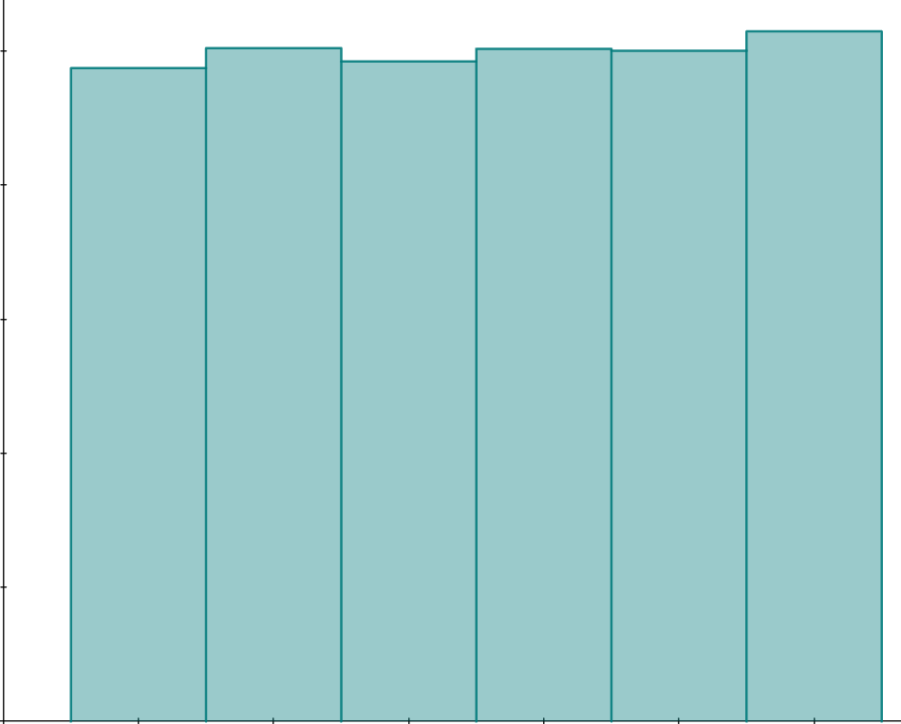
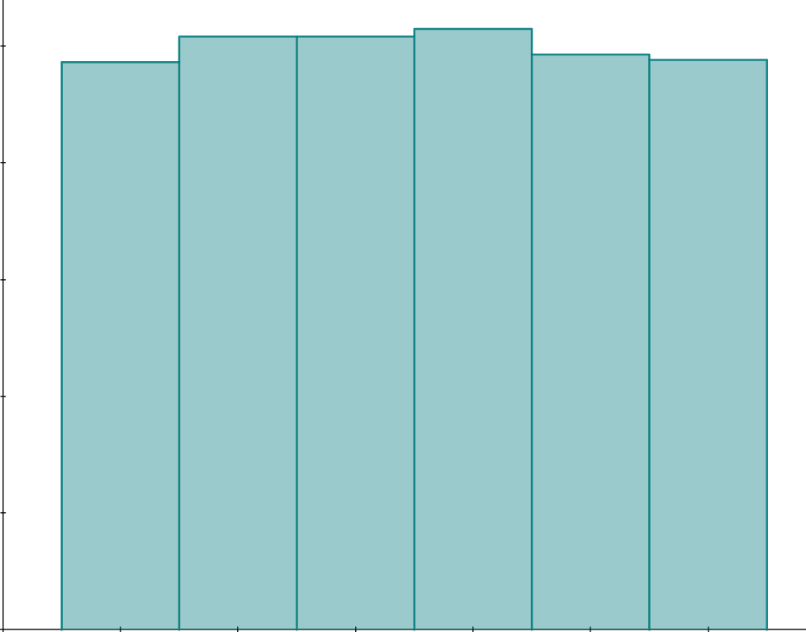
Considering the number of trials required
Experiments with a large number of trials are more likely to produce more consistent results.
E.g. rolling a dice 6000 times.
1000
1000
750
750
frequency
frequency
500
500
250
250
0
0
1
2
3
4
5
6
1
2
3
4
5
6
Use the link to see some simulations of experiments where a fair dice is rolled 6000 times. Move the slider to see the results from each experiment.
Notice how the results appear less varied between experiments.
dice - 6000 trials 🖇

Slide 38
Considering the number of trials required
If event A is more likely than event B, then A will always happen more often than B during an experiment.
An event that has a lower likelihood may still happen more often by chance.
When one event is more likely than another then it means that it will always happen more often.

Slide 39
Considering the number of trials required
If event A has a greater frequency than event B during an experiment, you can be certain that A is more likely than B.
An event that has a lower likelihood may still happen more often by chance.
The experiment proves that event A is more likely to happen again than event B.

Slide 40
Planning and conducting experiments
How could an experiment be improved to create a more reliable set of results?
Conduct an experiment with a greater number of trials.
Conduct an experiment with a smaller number of trials.
An experiment can never be improved.

Slide 41
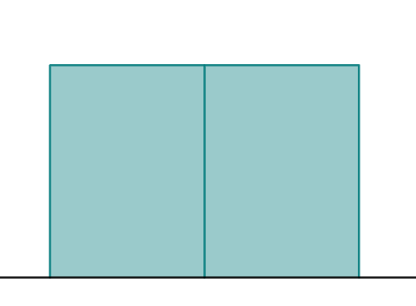
Considering the number of trials required
1) A class investigates which outcome is most likely when a frisbee is flipped.
a) An experiment is conducted with 10 trials. The bar chart shows the results.
Does one outcome appear more likely to happen than the other? If so, which one?
6
4
frequency
2
0
heads
tails

Slide 42
Considering the number of trials required
b) Use the link to access a simulation of this experiment: Frisbee flip simulation🖇 The box that says ‘count’ shows the number of trials completed. Press the ‘run’ button to begin the simulation and let it run for at least 500 trials.
How do the results from this experiment differ to those in part (a)?
c) Which experiment’s results seem more reliable? Justify your answer.

Slide 43
Considering the number of trials required
1) A class investigates which outcome is most likely when a frisbee is flipped.
a) An experiment is conducted with 10 trials. The bar chart shows the results.
Does one outcome appear more likely to happen than the other? If so, which one?
6
4
frequency
2
0
The outcomes appear equally likely.
heads
tails
Answers may vary depending on results from the simulation.

Slide 44
Considering the number of trials required
b) Use the link to access a simulation of this experiment: Frisbee flip simulation🖇 The box that says ‘count’ shows the number of trials completed. Press the ‘run’ button to begin the simulation and let it run for at least 500 trials.
How do the results from this experiment differ to those in part (a)?
E.g. ‘When using a large number of trials, heads happens slightly more often than tails. This could suggest that heads is slightly more likely than tails.’
c) Which experiment’s results seem more reliable? Justify your answer.
The results from the experiment in part (b) are more reliable because it uses a much greater number of trials.

Slide 45
Experiments to determine how likely an outcome is
An experiment can be designed to investigate whether one event is more likely than another.
An experiment is a repetition of a trial multiple times in order to observe how often each outcome occurs.
The results from an experiment can be used to determine the likelihood of each event.
A large number of trials may be needed in an experiment to produce reliable results.

Slide 46

© Oak National Academy 2024.
Produced in partnership with Mathematics in Education and Industry.
Licensed on the Open Government Licence v3.0, except where otherwise stated. See Oak terms and conditions.

